Slide 1
Immigration and the Constitution – Part Five
Mr. Mike’s 8th Grade Social Studies

Slide 2
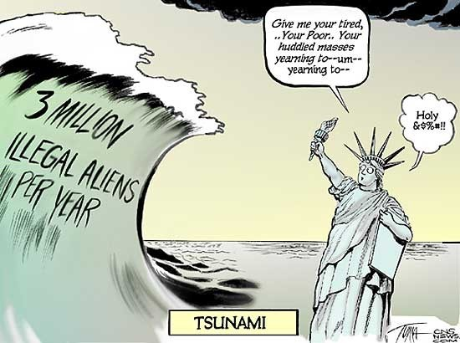
Media Literacy
For centuries, literacy has referred to the ability to read and write. Today, we get much of our information through multiple media technologies. Media literacy is the ability to access, analyze, evaluate, and create media.
Media literate people are better able to understand the complex messages we receive from television, radio, Internet, newspapers, magazines, books, billboards, video games, music, and all other forms of media.

Slide 3
Media Literacy and Justice
Media justice looks at the relationship between media and society. Our media system produces a lot of negative, demeaning imagery. It privileges some people and some perspectives, and ignores or silences others. It makes entire groups of people invisible. The media system provides too little funding and too few outlets for people without money, privilege and power to tell their stories.
The media system is unjust, and it perpetuates and strengthens injustice throughout society.

Slide 4
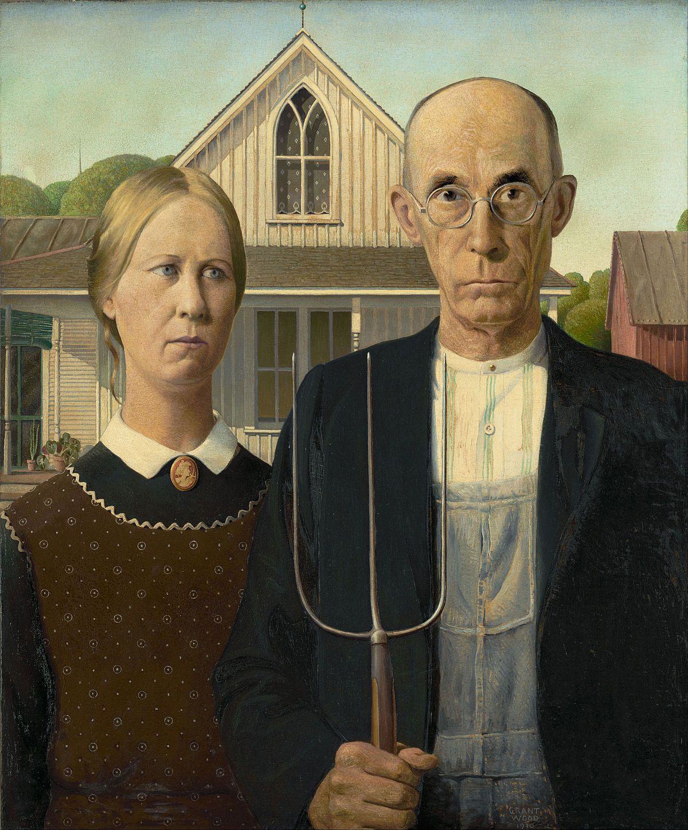
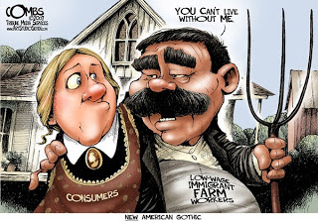
Media Literacy and Immigration
Use humor and our own symbols to tell your narrative.

Slide 5
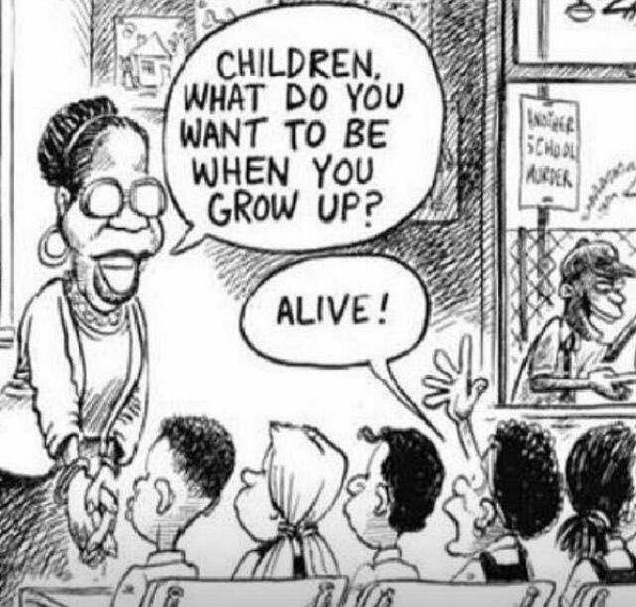
The Language of Persuasion
Speak back to injustice when you see it.

Slide 6
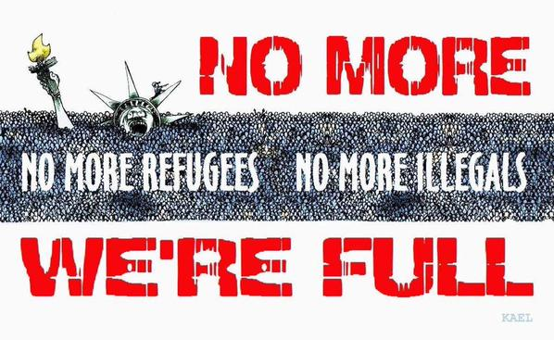
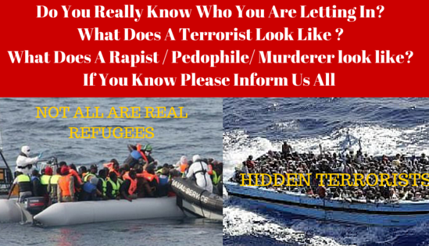
What’s the Message?

Slide 7
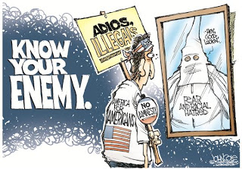
Who is the Audience?

Slide 8
Stereotyping the African American
There is not a single media representation of African-Americans. Depending on the genre (movie, television, news, documentary), the historical period, and the story being told, there may be a multitude or range of representations.
At the same time, even with all these representations, there are some common stereotypes we can see if we pay close attention to the patterns in what we’re viewing. Historically African-Americans have been portrayed as:
…athletes, gangsters, mammies, entertainers, welfare mothers, servants, drug dealers, video vixens, matriarchs, divas, deadbeat dads, violent, lazy, sexual, physical, or angry

Slide 9
The African American
After being criticized by some members of the African American community for playing roles that were deemed by many as racial stereotypes, McDaniel famously stated, “Why should I complain about making $700 a week playing a maid? If I didn't, I'd be making $7 a week being one.”
What do you think of McDaniel's stance?

Slide 10
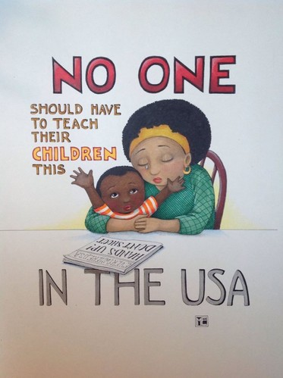
The African American
What do you see in this image created by Mary Engelbreit?
What contextual information do you need to know in order to understand the intended message?
What is the intended message?
What does the image say about African Americans?

Slide 11
The African American
This political parody by African American comedian Chris Rock presents a recorded message specifically targeted at white people. "In times like these you need a white president you can trust," Rock says, "and that president's name is Barack Obama." Rock proceeds to use a variety of facts to "prove" Obama's whiteness.
How does Chris Rock establish Obama's "whiteness"?
What criteria does he use?
How does Rock use humor to call into question the value and validity of judging a potential President by skin color?
Does the parody Rock uses invoke particular stereotypes about black and white Americans?
BTW, why do we racially hyphenate for every group except white people? White people are simply Americans. Everyone else is African American, Latin American, Asian American, Native American.

