Slide 1
Immigration and the Constitution
Mr. Mike’s 8th Grade Social Studies

Slide 2
What do you know?
Respond to the following statements in your notebook.
Most immigrants are here illegally.
It's easy to enter the country legally. My ancestors did; why can’t immigrants today?
Immigrants take good jobs from U.S. citizens.
Refugees are not screened before entering the United States.
“The worst” people from other countries are coming to the United States and are bringing crime and violence.
Undocumented immigrants don’t pay taxes and burden the national economy.

Slide 3
What does “We the people” mean to you?
Preamble to the Constitution
We the People of the United States, in Order to form a more perfect Union, establish Justice, insure domestic Tranquility, provide for the common defense, promote the general Welfare, and secure the Blessings of Liberty to ourselves and our Posterity, do ordain and establish this Constitution for the United States of America.

Slide 4
What is an Immigrant?
An immigrant is someone who chooses to resettle to another country.
The United States has a process for immigrants to seek legal residency and eventually citizenship.
Many immigrants, however, decided not to or could not enter this process and are thus undocumented. As such, they are subject to "removal" or deportation from the United States.

Slide 5
Myth #1: Most immigrants are here illegally
FACT: Of the more than 43 million foreign-born people who were living in the United States in 2014, around 44 percent were naturalized U.S. citizens. Those who were not naturalized were either lawful permanent residents, also known as green-card holders (27 percent of all foreign-born people), or immigrants who were unauthorized (some 11 million people, representing 25.5 percent of all foreign-born people).

Slide 6
Immigration - The System
The immigration system is built around two groups of people:
Immigrants
People who come to this country because of family
People who come here for economic reasons
People who come to this country as refugees or asylees.
Non-Immigrants
People who come to this country temporarily (students, tourists, seasonal workers)
Generally, this system operates apolitically. It is usually not influenced by the politics of the time. However, the system does reflect the values and priorities of the time and filters people according to those values and priorities.

Slide 7
Where do immigrants come from?
According to a 2012 study by the Pew Research Center, most immigrants to the United States come from the Asia-Pacific and Latin America-Caribbean regions. The study showed an increase in immigrants from Asia, Africa and the Middle East from 1992 to 2012 and a decrease in immigrants from Latin America, Europe and other parts of North America.

Slide 8
Myth #2: It's easy to enter the country legally. My ancestors did.
For about the first 100 years, the United States had an "open immigration system that allowed any able-bodied immigrant in." Back then, the biggest obstacle that would-be immigrants faced was getting here.
Today, however, there are many rules that specify who may enter and remain in the country legally. There is also a rigorous process for obtaining documentation to enter the United States as a resident, including applying for immigrant visas and permanent resident/green-card status.
Many immigrants who arrived between 1790 and 1924 would not have been allowed in under the current policy.

Slide 9
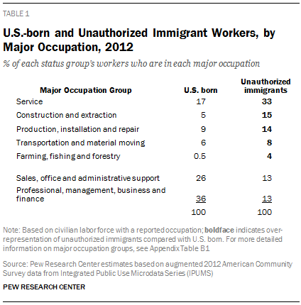
Myth #3: Immigrants take good jobs from U.S. citizens.
Total Money Income of Full-Time, Year-Round Workers 15 Years and Over by Sex, Nativity, and U.S. Citizenship Status: 2012
Sex and total money income¹ | Total |  | Nativity and U.S. citizenship status
 |  |  | Native |  | Naturalized U.S. citizen |  | Not a U.S. citizen
 | Number | Percent | Number | Percent | Number | Percent | Number | Percent
Both sexes | 103,062 | 100.0 | 86,036 | 100.0 | 8,236 | 100.0 | 8,790 | 100.0
.$1 to $14,999 or loss | 4,801 | 4.7 | 3,447 | 4.0 | 399 | 4.8 | 955 | 10.9
.$15,000 to $29,999 | 21,659 | 21.0 | 16,489 | 19.2 | 1,684 | 20.4 | 3,486 | 39.7
.$30,000 to $39,999 | 16,765 | 16.3 | 14,173 | 16.5 | 1,293 | 15.7 | 1,299 | 14.8
.$40,000 to $49,999 | 13,644 | 13.2 | 11,779 | 13.7 | 1,088 | 13.2 | 778 | 8.8
.$50,000 to $74,999 | 22,311 | 21.6 | 19,579 | 22.8 | 1,676 | 20.4 | 1,056 | 12.0
.$75,000 to $99,999 | 10,392 | 10.1 | 8,996 | 10.5 | 874 | 10.6 | 522 | 5.9
.$100,000 and over | 13,489 | 13.1 | 11,572 | 13.5 | 1,222 | 14.8 | 695 | 7.9
.Median income ($) | 45,535 | X | 46,792 | X | 46,171 | X | 29,551 | X
Male | 59,011 | 100.0 | 48,426 | 100.0 | 4,611 | 100.0 | 5,974 | 100.0
.$1 to $14,999 or loss | 2,302 | 3.9 | 1,538 | 3.2 | 203 | 4.4 | 561 | 9.4
.$15,000 to $29,999 | 10,392 | 17.6 | 7,396 | 15.3 | 741 | 16.1 | 2,255 | 37.7
.$30,000 to $39,999 | 8,525 | 14.4 | 6,922 | 14.3 | 693 | 15.0 | 909 | 15.2
.$40,000 to $49,999 | 7,460 | 12.6 | 6,285 | 13.0 | 598 | 13.0 | 576 | 9.6
.$50,000 to $74,999 | 13,290 | 22.5 | 11,603 | 24.0 | 971 | 21.1 | 716 | 12.0
.$75,000 to $99,999 | 6,981 | 11.8 | 6,056 | 12.5 | 533 | 11.6 | 392 | 6.6
.$100,000 and over | 10,060 | 17.0 | 8,625 | 17.8 | 872 | 18.9 | 564 | 9.4
.Median income ($) | 50,683 | X | 52,000 | X | 50,752 | X | 31,014 | X
Female | 44,051 | 100.0 | 37,610 | 100.0 | 3,625 | 100.0 | 2,816 | 100.0
.$1 to $14,999 or loss | 2,499 | 5.7 | 1,909 | 5.1 | 196 | 5.4 | 394 | 14.0
.$15,000 to $29,999 | 11,267 | 25.6 | 9,093 | 24.2 | 943 | 26.0 | 1,231 | 43.7
.$30,000 to $39,999 | 8,240 | 18.7 | 7,251 | 19.3 | 600 | 16.5 | 389 | 13.8
.$40,000 to $49,999 | 6,184 | 14.0 | 5,493 | 14.6 | 489 | 13.5 | 202 | 7.2
.$50,000 to $74,999 | 9,021 | 20.5 | 7,976 | 21.2 | 705 | 19.4 | 340 | 12.1
.$75,000 to $99,999 | 3,411 | 7.7 | 2,940 | 7.8 | 341 | 9.4 | 130 | 4.6
.$100,000 and over | 3,428 | 7.8 | 2,948 | 7.8 | 350 | 9.7 | 130 | 4.6
.Median income ($) | 40,019 | X | 40,625 | X | 40,915 | X | 25,984 | X

Slide 10
What is a Refugee?
A refugee is someone who has been forced to flee his or her home country.
Refugees can apply for asylum in the United States, a process that could take years.
Getting refugee status isn't easy. The applicants have to prove that if they return to their home country, they'll be injured because of their race, religion, nationality, membership in a particular social group or their political opinion.

Slide 11
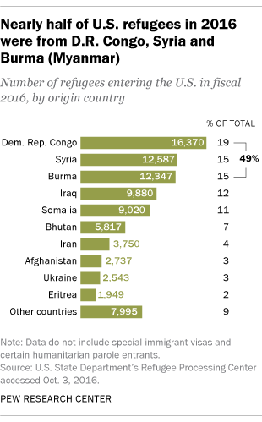
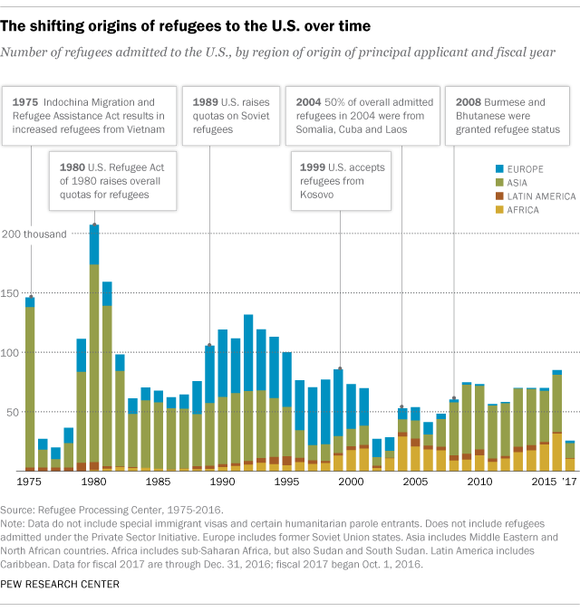
Where do refugees come from?

Slide 12
Myth #4: Refugees are not screened before entering the United States.
FACT: Refugees undergo more rigorous screenings than any other individuals the government allows in the United States. It remains an extremely lengthy and rigorous process, which includes multiple background checks; fingerprint tests; interviews; health screenings; and applications with multiple intelligence, law enforcement and security agencies. The average length of time it takes for the United Nations and the United States government to approve refugee status is 18 to 24 months.

Slide 13
What is Asylum?
Asylum is the legal protection given to a person by the United States government who can demonstrate a “well-founded fear of persecution” based on race, religion, nationality, political opinion, or membership in a particular social group.
Asylees are different from refugees because they are in the country. They are seeking protection from deportation after having entered the United States, legally or illegally. Refugees are persons who are not in the U.S. and have asked for protection.
The opportunity to apply for asylum is offered to both refugees outside the United States and people who have entered the country illegally. Those who can demonstrate a credible fear of returning to their home country due to past persecution based on any of the five protected grounds may receive status in the United States. Gender discrimination and rape as an act of war are not grounds for asylum.

Slide 14
Myth #5: “The worst” people from other countries are coming to the United States and are bringing crime and violence.
Immigrants come to this country for a few primary reasons: to work, to be reunited with family members or to escape a dangerous situation. Most are couples, families with children, and workers who are important to the U.S. economy. Statistics show that immigrants are less likely to commit serious crimes or be behind bars than native-born people are, and high rates of immigration are associated with lower rates of violent crime and property crime.
For instance, “sanctuary counties” average 35.5 fewer crimes per 10,000 people compared to non-sanctuary counties. This holds true for immigrants who are documented and undocumented, regardless of their country of origin or level of education.
In other words, the overwhelming majority of immigrants are not “criminals.”

Slide 15
Myth #6: Undocumented immigrants don’t pay taxes and burden the national economy.
Immigrants who are undocumented pay taxes every time they buy taxable goods such as gas, clothes or new appliances. They also contribute to property taxes—a main source of school funding—when they buy or rent a house or apartment.
A 2017 report from the Institute on Taxation and Economic Policy highlights that undocumented immigrants pay an estimated $11.74 billion in state and local taxes a year.
The U.S. Social Security Administration estimated that in 2010 undocumented immigrants—and their employers—paid $13 billion in payroll taxes alone for benefits they will never get. They can receive schooling and emergency medical care but not welfare or food stamps.
Under the 1996 welfare law, most government programs require proof of documentation, and even immigrants with documents cannot receive these benefits until they have been in the United States for more than five years.

Slide 16
Personal Stories

